Slide 1
Data Visualization with R
Gladstone Institutes
Leandro Lima, Ayushi Agrawal, Anders Riutta
Bioinformatics Core, GIDB
December, 2021

Slide 2
Introductions
Leandro Lima, Bioinformatician II
Ayushi Agrawal, Bioinformatician II
Anders Riutta, Software Engineer III (T.A.)

Slide 3
Poll question
Prior experience with R?
None - I do not know what R is
Beginner - I can perform basic operations in R
Intermediate - I have used R before for some analyses
Expert - I use R all the time

Slide 4
Outline
R refresher
Introduction to ggplot2
Break (10 min)
Hands-on Part 1
Break (10 min)
Hands-on Part 2
Recommendations for making figures (10 simple rules)
Conclusion

Slide 5
Part 1 Outline
Introduction
Hands-on analysis
Explore Iris data and save a publication-ready figure.
Data: “iris.csv”
Result: “Iris.pdf”
Script: “1. iris.R”
Brief digression to save a heatmap.
Data: “norm_counts.txt”
Results: “Heatmap.pdf” and “Heatmap.tiff”
Script: “5. Heatmap.R”
Conclusion

Slide 6
Part 2 Outline
Introduction
Hands-on analysis
Plot and annotate nucleotide-resolution data.
Data: “nucleotide_resolution.RData”
Result: “Nucleotide_resolution.pdf”
Script: “2. nucleotide_resolution.R”
Miscellaneous
Interactive data visualization
Visualization options beyond ggplot2
Conclusion

Slide 7
R topics covered
Hands on
Plotting with ggplot2.
Writing loops.
Saving figures in high resolution.
Plotting heatmaps.
Time-permitting
Interactive data visualization with Shiny.

Slide 8
Assumed background
Familiarity with R and RStudio.
Basic arithmetic operations in R.
Variables and assignments.
Commenting in scripts.
Functions and libraries.
Read, subset and explore data.
Basic plotting of data.
Data structures available in R.
Troubleshooting.

Slide 9
Reading resources
ggplot2 cheatsheet. (download link in description)
ggplot2: Elegant Graphics for Data Analysis by Hadley Wickham. (download link in description)
The Grammar of Graphics by Leland Wilkinson. (download link in description)
Material from Introduction to R workshop on GitHub.
Notes:
https://rstudio.com/wp-content/uploads/2015/03/ggplot2-cheatsheet.pdf
https://link.springer.com/book/10.1007%2F978-0-387-98141-3
https://link.springer.com/book/10.1007%2F0-387-28695-0

Slide 10
Refresher

Slide 11
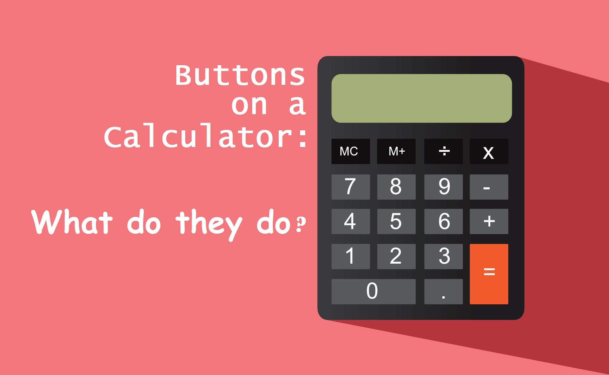
R:= Calculator with more “buttons” than you'll ever use.
R can do all that a calculator can.
Open R.
Try 2+3.
Try 2*3.
Try (2+3)/5.
Conclusion: Off with the calculators!

Slide 12
R is a console application.
Text only interface. Inputs and outputs can be images.
RStudio: Brings more Graphical User Interface (GUI) features to R.
RStudio is to R as Microsoft Word is to Notepad in Windows or TextEdit in Mac. (~kinda)

Slide 13
Commenting inside a source script
Looking at an old script, or someone else’s script can be scary.
Speak to machine in code.
Leave comments in natural language (e.g., English).
Anything written after # is interpreted by R as a comment for humans.

Slide 14

Empty workspace/environment

Slide 15
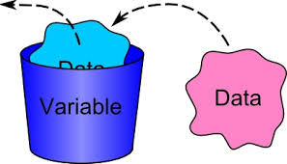
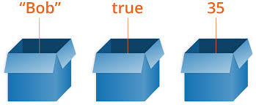

Data analysis creates objects that store data. (top-right pane in RStudio)

Slide 16
Data structures

Slide 17




Data structures are data organization/storage formats.
Storing data physically? Options:
Sticky note
Printer paper
Task pad
Long scroll

Slide 18
Data structures are data organization/storage formats.
Working with data in R? Options:
Numeric vector
c(2, 5, 10, 11)
Character vector
c(“apples”, “oranges”, “butter”, “dry yeast”)
Data frames
dat from Iris example.
Matrix
Example counts for genes in several samples.
Lists
Flexible data structures.
mylist <- list(a = c(2, 5, 10, 11),
b = c(“apples”, “oranges”, “butter”, “dry yeast”)
)

Slide 19
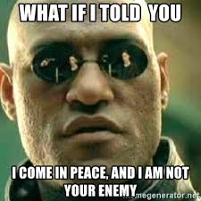
Error!!!

Slide 20
Functions

Slide 21
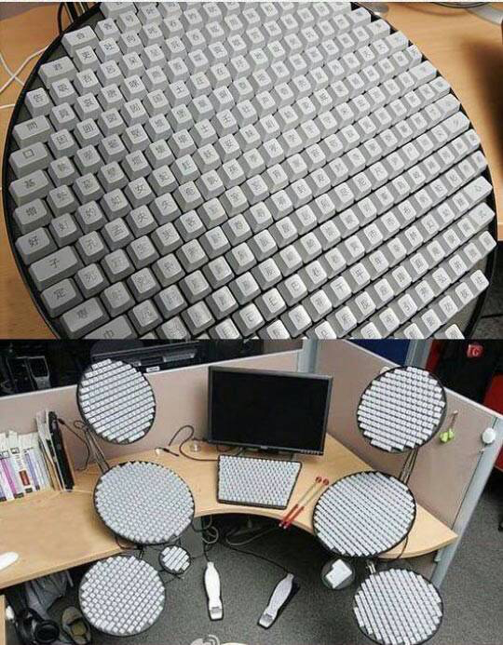
Working with buttons for modern scientific calculations?
The best of calculators => 10s of buttons for specific tasks.
Modern science needs many times more than 10s.

Slide 22
Functions are to R what buttons are to calculators.
R can perform 100s of 1000s of tasks.
Tasks are performed by using functions.
Examples: sum(), prod(), mean(), t.test().
Result1
DatasetA
function()
DatasetB
Result2
DatasetC
Result3

Slide 23
There are functions for all sorts of things.
Example to read a table saved in a file:
read.table()
Usage: read.table(“filename”)
read.table()
Data is displayed in R.
File name

Slide 24
There are functions for all sorts of things.
Example to find complementary DNA sequence.
complement()
Usage: complement(sequence)
complement()
TGCA
ACGT

Slide 25
There are functions for all sorts of things.
Example to install a package in R.
install.packages()
Usage: install.packages(“ggplot2”)
Install.packages()
Package name
Package installed

Slide 26
Directing output of one function as input to another.
read.table()
edgeR()
List of differentially expressed genes.
Data is displayed in R.
File name

Slide 27
Library is a collection of functions.
R works with > 100000 functions.
More being added everyday.
If the software were to load (i.e., make available) all of them at startup, it will take a while to launch.
Solution: Bundle related functions together in a library.
Example: edgeR.
Load functions only when needed. (:= Install apps on smartphone as needed)

Slide 28
Functions may need lots of information
Calculators may take only numbers.
R functions take variety of things. Numbers, characters, etc.
Example:
Reading a file. Inputs required: File name and address on computer, formatting of file, type of file, etc.
Writing a file. Inputs required:
what to write?
where to write?
how to format the file?
Include column names, row names?
separate with comma?

Slide 29
ggplot2: Package with functions for plotting.
R can perform 100s of 1000s of tasks.
Tasks are performed by using functions.
Examples: sum(), prod(), mean(), t.test().
Result1
DatasetA
function()
DatasetB
Result2
DatasetC
Result3
‹#›

Slide 30
ggplot2: Package with functions for plotting.
Plotting layer-by-layer.
Function names:
qplot
ggplot
Data
ggplot()
Where to plot?
Plot
Details on how to plot
‹#›

Slide 31
Break (10 min)

Slide 32
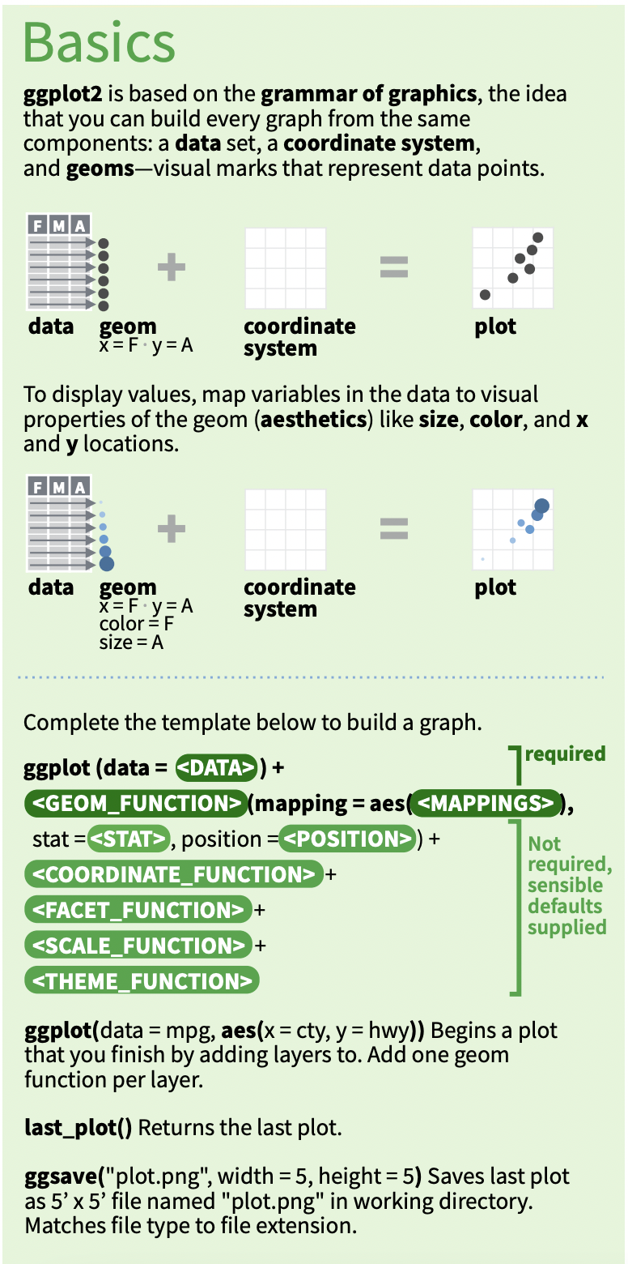
ggplot2 basics
ggplot2 cheat sheet
Notes:
Additional resource: https://ggplot2.tidyverse.org/

Slide 33
There are two functions for generating plots in ggplot2: qplot() and ggplot().
qplot function has some advantages over ggplot:
Easier syntax
Can visualize vectors and data frames
Still, qplot has many disadvantages compared to more powerful ggplot function:
Limited options
Difficult to modify the plots
ggplot is much more flexible.
ggplot2 basics
ggplot2 cheat sheet
Notes:
Additional resource: https://ggplot2.tidyverse.org/

Slide 34
ggplot2 components
ggplot2 cheat sheet
“+” is used to separate the layers

Slide 35
Hands-on: Part 1

Slide 36
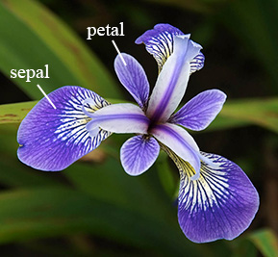
Explore Iris data and save a publication-ready figure.
Data: “iris.csv”
Iris is a plant genus.
Species of this genus may be identified based on the dimensions of petals and sepals of its flowers.
Result: “Iris.pdf”
Script: “1. iris.R”
An example of iris flower and the features in our data

Slide 37
Additional resources
Q&A: https://stackoverflow.com/
More on arranging figures for publications.
https://cran.r-project.org/web/packages/egg/vignettes/Ecosystem.html

Slide 38
Notes on geometrical attributes of data.

Slide 39
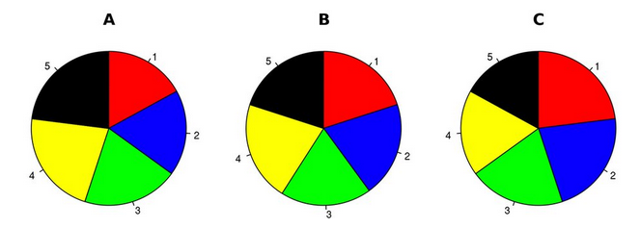
Which color occupies third largest area?

Slide 40
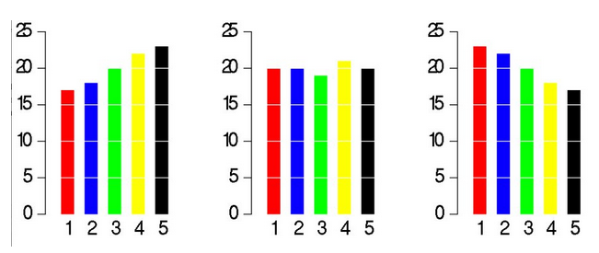
We are better at comparing lengths than areas.

Slide 41
“The purpose of data visualization is insight, not pictures.”
See link in description.
Notes:
https://www.interaction-design.org/literature/book/the-encyclopedia-of-human-computer-interaction-2nd-ed/data-visualization-for-human-perception
The quote in Title is by Ben Shneiderman.

Slide 42
Brief digression to heatmaps

Slide 43
Save a heatmap for counts of genes.
Data: “norm_counts.txt”
Results: “Heatmap.pdf” and “Heatmap.tiff”
Script: “5_Heatmap.R”

Slide 44
Conclusion (Part 1)
Need good grammar for effective communication.
Grammar of Graphics for plotting data.
Scripts for high-resolution graphics.
Reproducible research.
Fine control over all of plotting area.
Easily change/reproduce figures with alternate themes/annotations.
Part 2:
Exploring large-scale data enabled by automated plotting.
Integrate information from multiple sources on same plot.

Slide 45
Break (10 min)

Slide 46
Hands-on: Part 2

Slide 47
Plot and annotate nucleotide-resolution data.
Data: “nucleotide_resolution.RData”
One value for six replicates of each nucleotide of > 10000 genes.
Need to plot specific regions of 10 genes and annotate motifs.
…
Result: “Nucleotide_resolution.pdf”
Script: “2. nucleotide_resolution.R”

Slide 48
Your feedback is important to us!
https://www.surveymonkey.com/r/F75J6VZ
~3 min.

Slide 49
Hands-on: Additional

Slide 50
Flip book type animation for characteristics of Hill equation.
Data: To generate using Hill equation.
Hill equation gives reaction velocity in terms of substrate concentration.
https://en.wikipedia.org/wiki/Hill_equation_(biochemistry)
Result: “Hill_equation.pdf”
Script: “3. Hill_equation_static.R”

Slide 51
Interactive visualization for characteristics of Hill equation using Shiny.
Data: To generate using Hill equation.
Hill equation gives reaction velocity in terms of substrate concentration.
https://en.wikipedia.org/wiki/Hill_equation_(biochemistry)
Result: Interactive application is launched.
Script: “4. Hill_equation_interactive.R”

Slide 52
Interactive visualization with Shiny.
Need to define user interface (UI).
Need to serve data/figures to UI and communicate input values.
Notes:
https://shiny.rstudio.com/gallery/

Slide 53
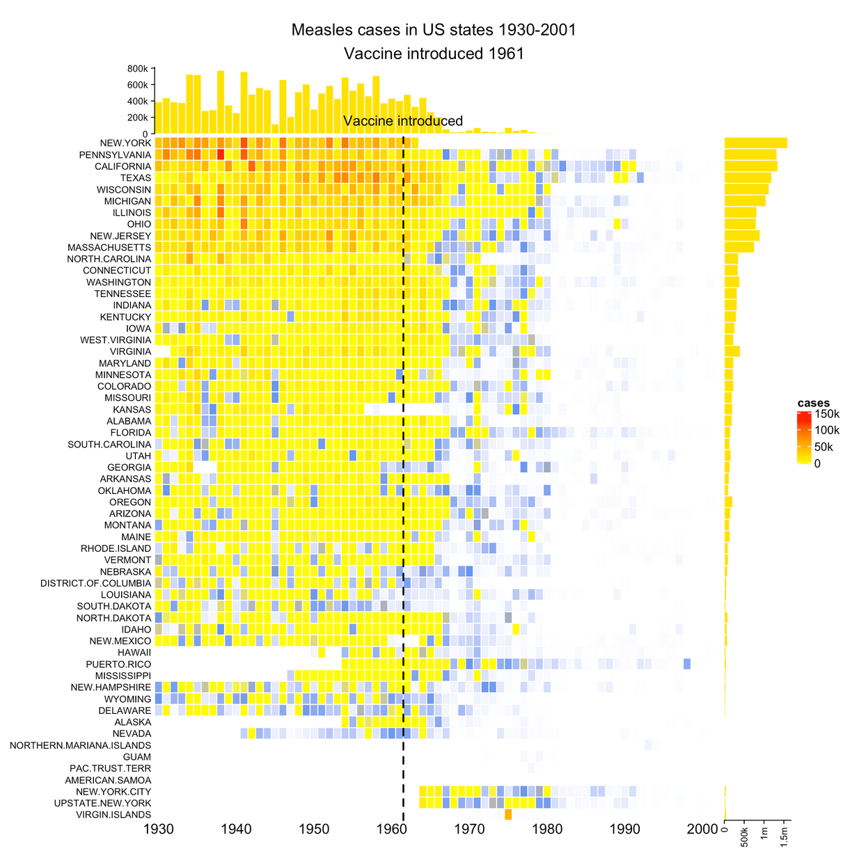
Beyond ggplot2: 1. Heatmap.
Check out a package called ComplexHeatmap.

Slide 54
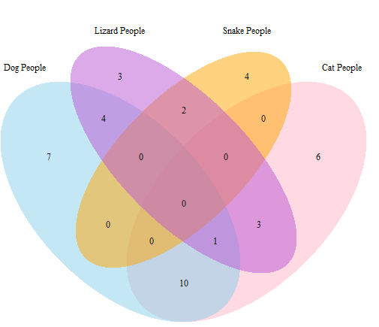
Beyond ggplot2: 2. Venn diagram with multiple sets.
See link in description.
Notes:
https://rstudio-pubs-static.s3.amazonaws.com/13301_6641d73cfac741a59c0a851feb99e98b.html

Slide 55
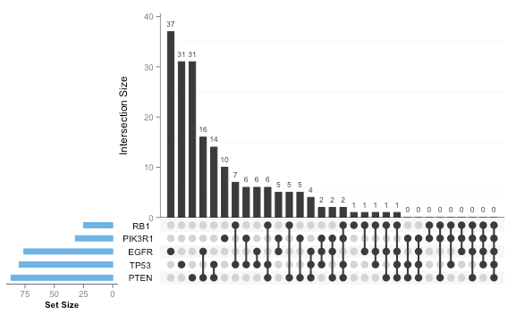
Beyond ggplot2: 2. Venn diagrams with multiple sets (alternative).
See link in description.
Cat
Dog
Lizard
Snake
Cow
Notes:
https://cran.r-project.org/web/packages/UpSetR/README.html
Note that the data displayed on this slide is not the same as that on the previous slide.

Slide 56
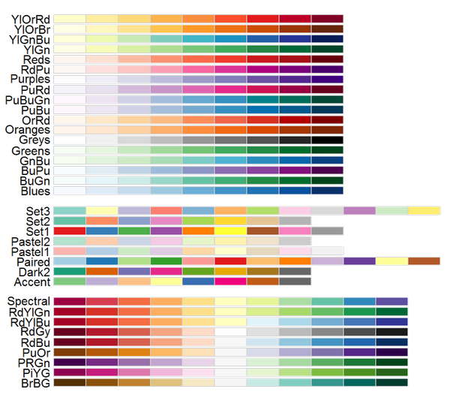
Beyond ggplot2: 3. Select color palettes using RColorBrewer.
See link in description.
Notes:
https://earlglynn.github.io/RNotes/package/RColorBrewer/index.html

Slide 57
Additional resources

Slide 58
R topics covered
Hands on
Plotting with ggplot2.
Writing loops.
Saving figures in high resolution.
Plotting heatmaps.
Time-permitting
Interactive data visualization with Shiny.

Slide 59
Examples of high-resolution graphics
https://www.r-graph-gallery.com/

Slide 60
Interactive visualization with Shiny
https://shiny.rstudio.com/gallery/

Slide 61
Recommendations for making figures
10 simple rules
https://journals.plos.org/ploscompbiol/article?id=10.1371/journal.pcbi.1003833#s6

Slide 62
Conclusion
Need good grammar for effective communication.
Grammar of Graphics for plotting data.
Exploring large-scale data enabled by automated plotting.
Integrate information from multiple sources on same plot.
Scripts for high-resolution graphics.
Reproducible research.
Fine control over all of plotting area.
Easily change/reproduce figures with alternate themes/annotations.

Slide 63
